Slide 1


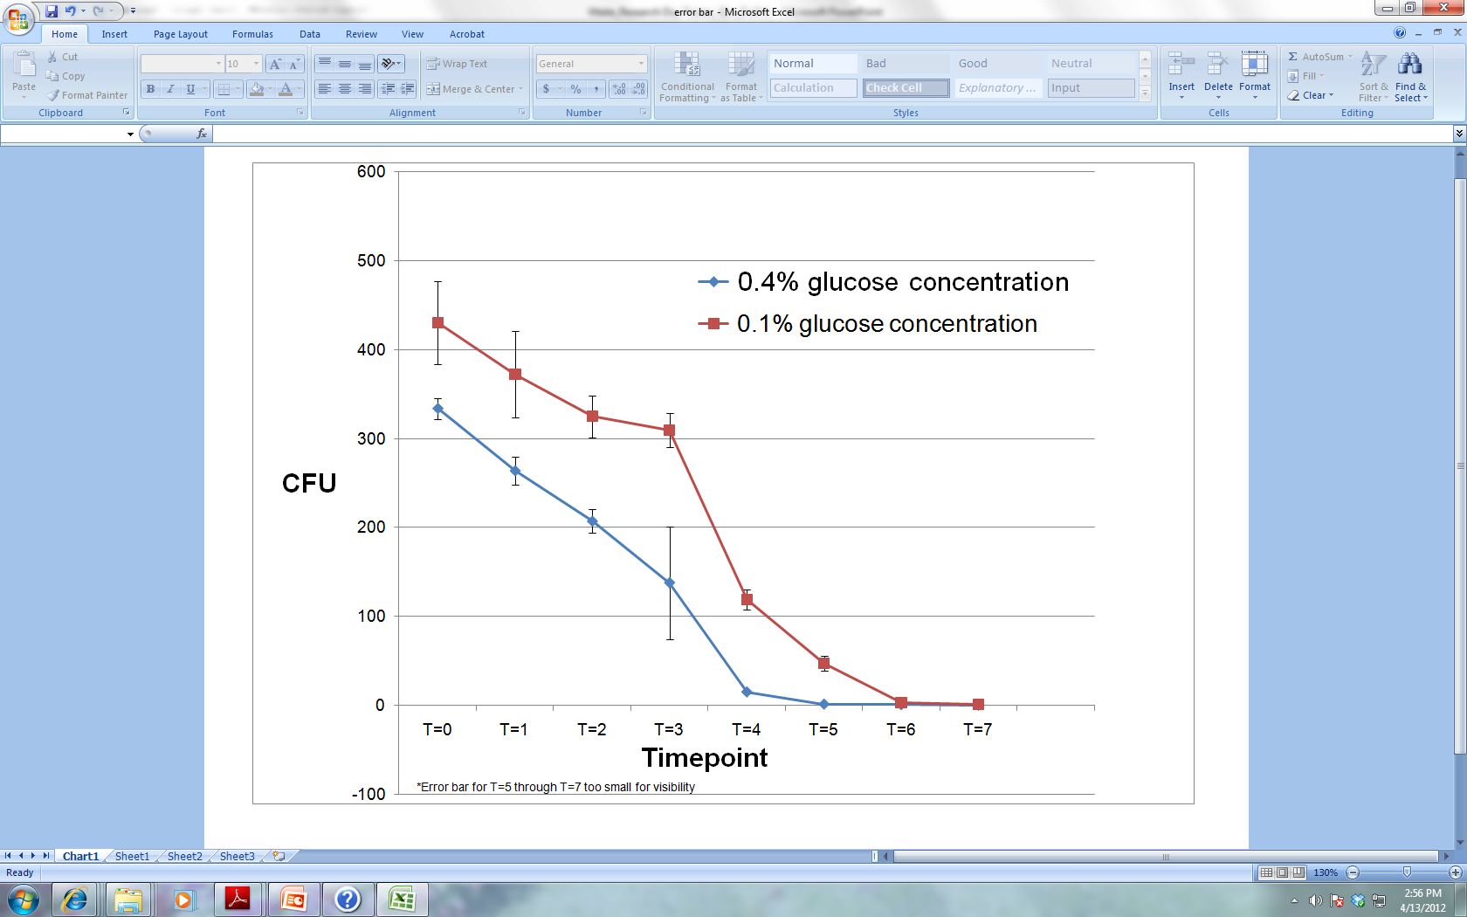
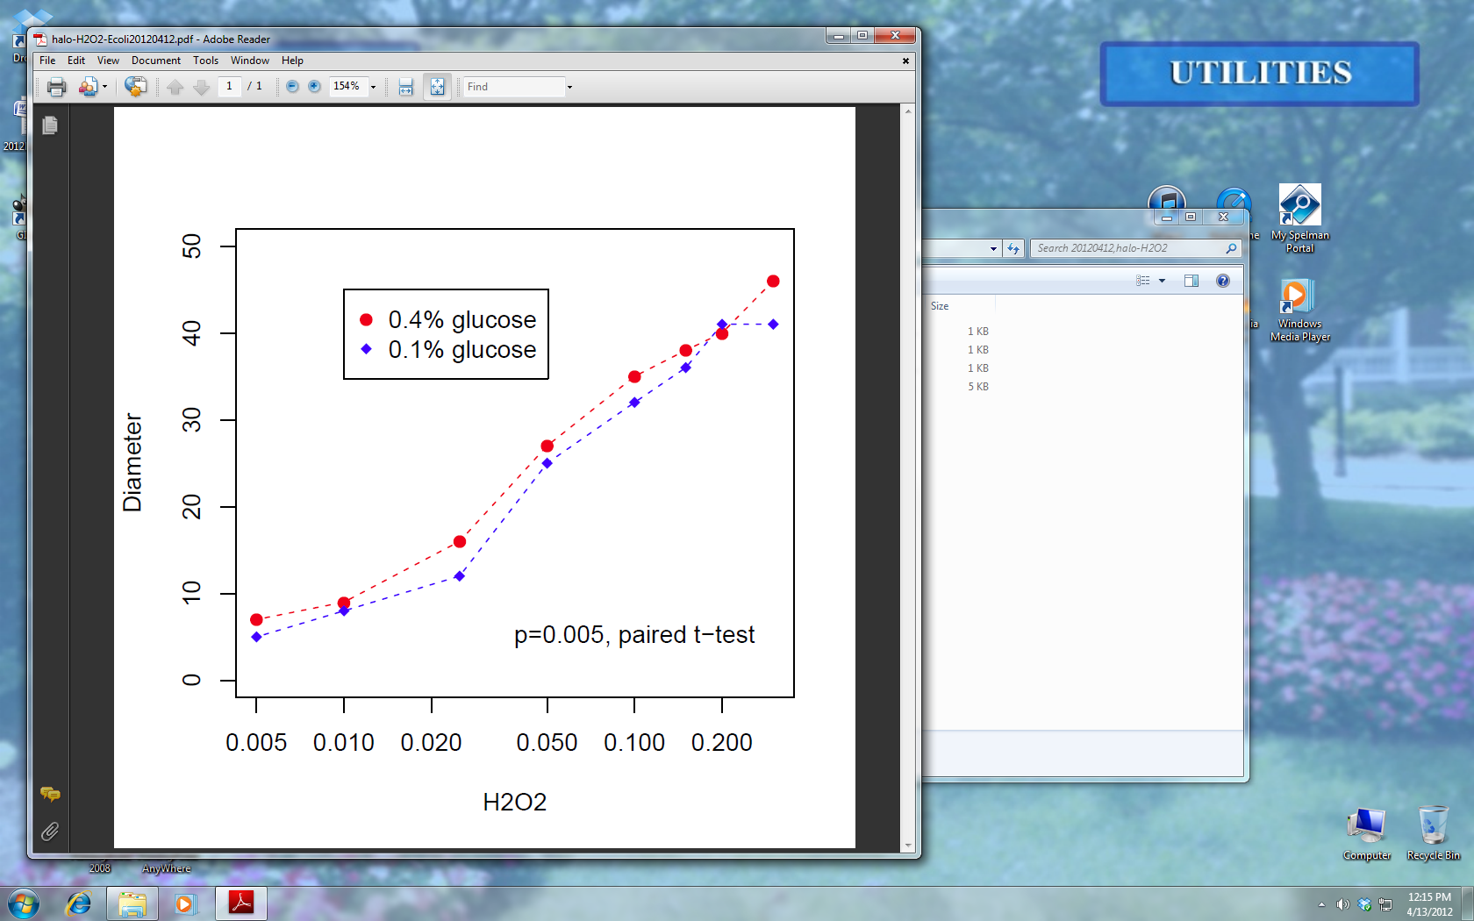
Effect of Caloric Restriction on Escherichia coli Aging Morgan Maite, Nilin Gupta, Hong Qin Biology Department
Overview
Calorie restriction (CR) is an effective method for lifespan extension in eukaryotes. TOR mediated nutrient sensing pathway and mitochondria play key roles in the lifespan extension effect of CR in eukaryotes. E. coli is a prokaryotic bacterium without mitochondria, and no otholog for TOR has been found in E. coli. Here, we investigated whether CR can extend the lifespan of E. coli cells. We found that E. coli grown in low concentration of glucose live longer than those grown in higher concentration of glucose. We also studied the lifespan of E. coli cells treated with osmolarity shock and rapamycin. Rapamycin is an antibiotics that targets TOR complex in eukaryotic cells. Our study can address whether TOR-independent pathways can also play a role in lifespan extension effect of CR, and whether mitochondria is indeed an essential factor of CR. This research was supported by the National Science Foundation under Award #1022294 RUI: Testing the network hypothesis of Cellular Aging in Saccharomyces Cerevisiae
Survival Curve
Figure 1a. E. coli (PRS413) was grown in 0.4% and 0.1% glucose concentrations. The cultures were plated and CFU was measured to develop the survival curve of the bacteria. The survival curve of PRS413 found in Figure 1b. shows that 0.1% glucose concentration has a longer replicative lifespan than 0.4% thus replicative lifespan is extended in CR.
Discussion
Rapamycin inhibits Target of Rapamycin (TOR) proteins from down regulating. Previous studies have shown the effect of Rapamycin on TOR increases replicative lifespan in S. cerevisiae. This study aims to treat E. coli, a prokaryotic organism lacking both mitochondria and TOR with Rapamycin and H2O2. Normally, the TOR pathway is activated in CR signaling the expression of starvation genes. No ortholog for TOR has been found in E. coli, therefore no effect should be observed on the lifespan of the cell when grown in CR or treated with Rapamycin. E. coli does have an ortholog for SIR2 a gene in the Sirituin family that when overexpressed extends S. cerevisiae lifespan during starvation signaling. A pathway independent of TOR may be activated during CR similar to the SIR2 pathway. This novel approach to examining senescence in Escherichia coli could yield great results that may potentially lead to a solution reducing the overall prevalence of E. coli. This experimental design is currently in progress and will be continued during the summer of 2012. Presently, a parallel study is being conducted to determine the affect of osmolarity on the survival curve of E. coli under conditions favoring caloric restriction.
Grow Escherichia coli : PRS413
(LB and 1XM9)
CR
.4%glucose
.1% glucose
Figure 1a.
Figure 1b.
S. cerevisiae | E.coli
Eukaryote | Prokaryote
TOR1 | No ortholog found for TOR1
Mitochondria | No membrane-bound organelles
SIR2 | Ortholog for SIR2
Conclusions
Caloric Restriction may extend lifespan within E.coli, thus a pathway independent of TOR and similar to SIR2 may be activated
Caloric Restriction may increase E. coli resistance to H2O2
Objectives
Determine the functional capability of E. coli, a prokaryotic organism lacking mitochondria and TOR in growth conditions favoring caloric restriction (CR).
Hypothesis
In CR the lifespan of E. coli will increase as pathways independent of TOR will activate in the presence of starvation signaling.
Materials and Methods
Escherichia coli Rapamycin
Glucose Hydrogen Peroxide
Minimal Growth Media (M9) Escherichia coli plates
Grow the E. coli culture in LB media for 24hours. Harvest the cells and grow them for an additional 24 hours in M9 with varying concentrations of glucose (.01% and 0.4% concentration). Plate the cells and obtain the CFU value, this value is used to obtain the survival curve of the bacteria. Repeat the steps and treat the plates with varying concentrations of H2O2. Measure the diameter of the halo ring and determine which concentration is least effected by H2O2.
H2O2 Treatment
Figure 2a. E. coli PRS413 was grown in CR and treated with varying concentrations of H2O2. In Figure 2b. (above) 0.1% glucose concentration, favoring CR has a higher resistance to the effects of H2O2 than the 0.4% glucose concentration.
Future Studies
1) Identify the independent pathway activated in CR
2) Determine the signaling pathway of the independent pathway
H202
30,20,15,10,5,2.5,1,.5% concentration
Grow Escherichia coli : PRS413
Figure 2a.
Acknowledgements
We would like to thank Jayden LeBlanc for assistance in the duration of this project. Additionally, we thank NSF Award #1022294.
References
Ackermann, M., Sterns, S. and Jenal, U. (2003) Senescence in a bacterium with asymmetric division. Science. 300: 1920.
Kaeberlein M, et al. (2005) Regulation of yeast replicative life span by TOR and Sch9 in response to nutrients. Science 310(5751):1193
Nystrom, T. (1994) The glucose-starvation stimulon of Escherichia coli. Molecular Microbiology. 12(5): 833-843.
Nystrom, T., Fredriksson A. (2006) Conditional and replicative senescence in Escherichia coli. Current Opinion in Microbiology 9:612-618
Figure 2b.

